Slide 1
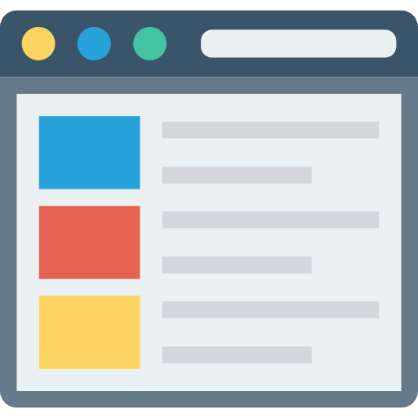
E-commerce Website
Online Shop Tracking System
Created by Zahid Khattak

Slide 2




Group Members
1
2
3
Muhammad Shahzad
Bilal Ahmad
Muhammad Zahid
The Designer for our Project
The Frontend Developer for our Project
The Backend Developer for our Project
Created by Zahid Khattak

Slide 3




Agenda
Introduction of our system
Features
Languages & Tools
GUI (Graphical User Interface )
Created by Zahid Khattak

Slide 4



Introduction of Our System
The Online Shop Tracking System is a web based application where customers can see a
store's products, prices, and stock online. It provides an easy-to-use platform so customers can browse all the products available from a store without needing to go out. And people can buy and add to cart the products.
Created by Zahid Khattak

Slide 5

Features
Seller Features
Seller is able to add new goods & Products
Additionally, the Seller can Delete Products
All the Buyers are visible to the Seller
The seller is able to view every order as well as who placed the product order.
Created by Zahid Khattak

Slide 6
Features
Buyers Features
A buyer can add an item to their cart
A buyer can place an order by just clicking the `order` button
Buyers can view the location of the store on a map
Created by Zahid Khattak

Slide 7







Languages
Languages for Development
HTML (Hyper Text Markup Language)
CSS (Cascading style Sheet)
JavaScript (Language for adding functionality)
Bootstrap (The CSS Framework)
MySQL (Database for storing Data)
PHP (Backend Language)
Created by Zahid Khattak

Slide 8




Tools
Tools we used for our Project
Figma (For Designing)
VS Code (Visual Studio Code for coding)
Git & GitHub (For Collaboration)
Created by Zahid Khattak

Slide 9



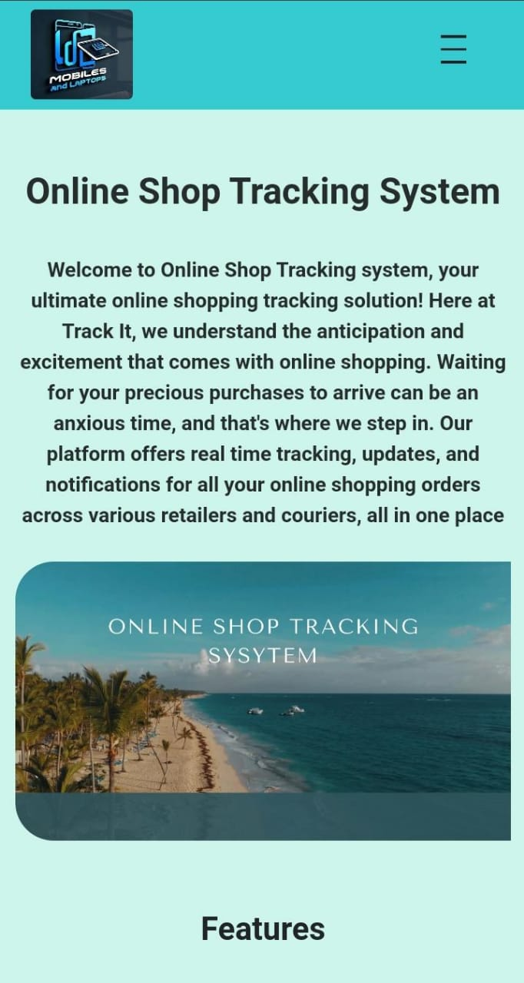
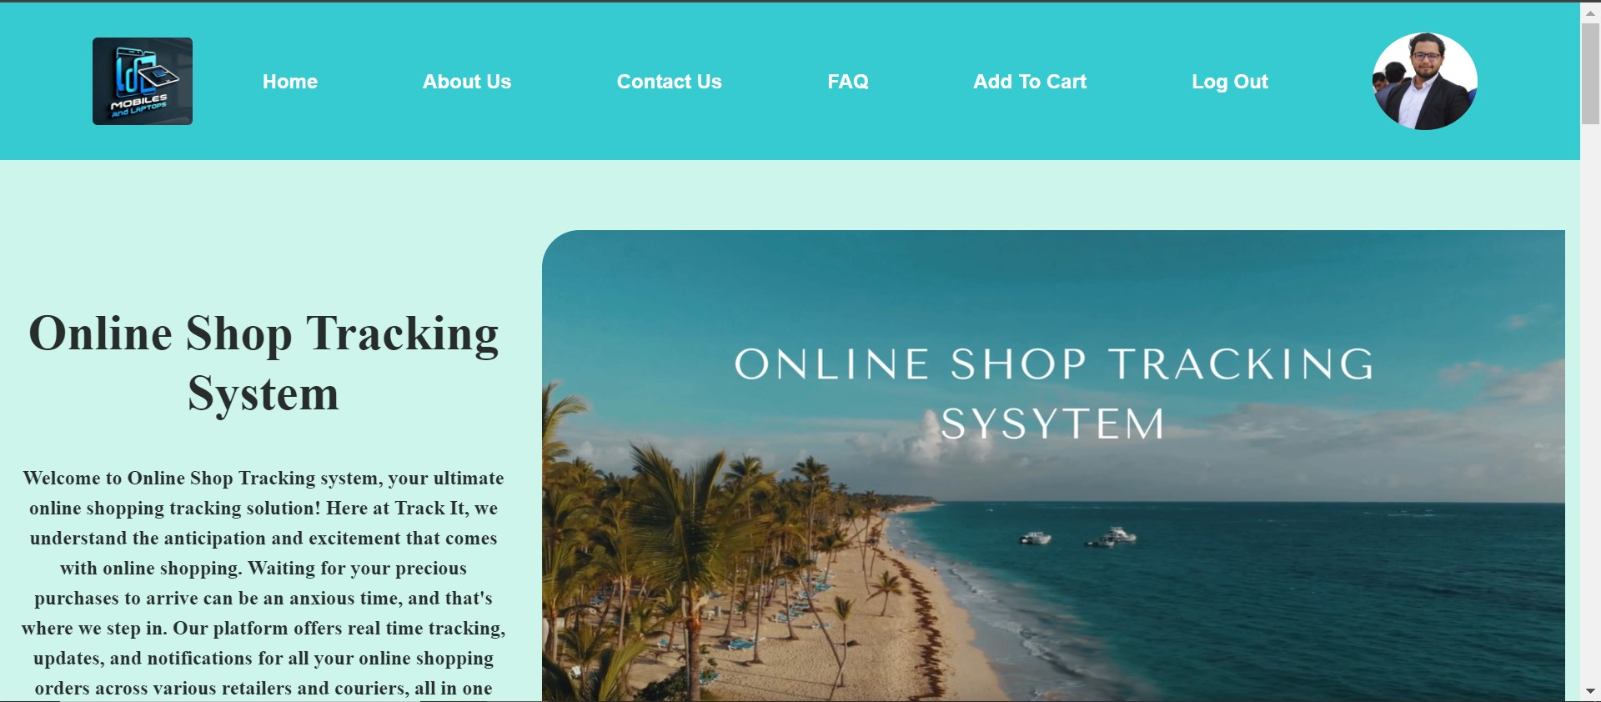
GUI (Graphical User Interface) Home Page
Created by Zahid Khattak
This Photo by Unknown Author is licensed under CC BY-NC

Slide 10
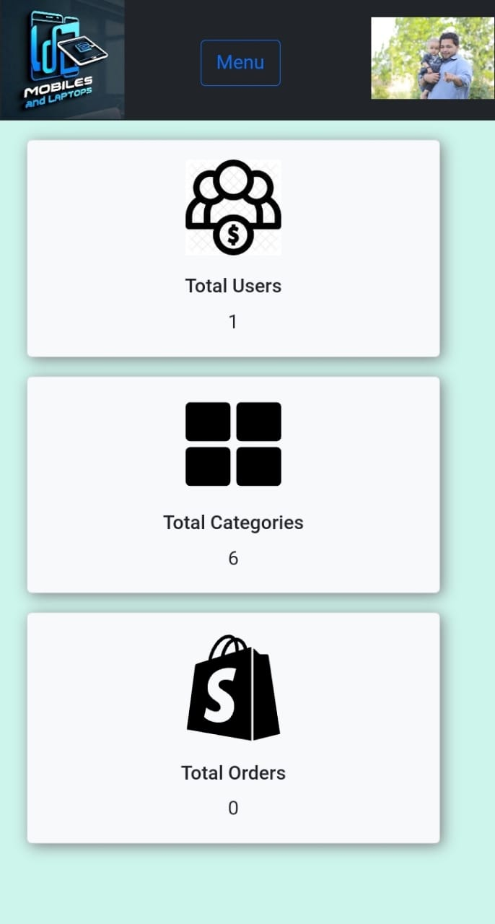
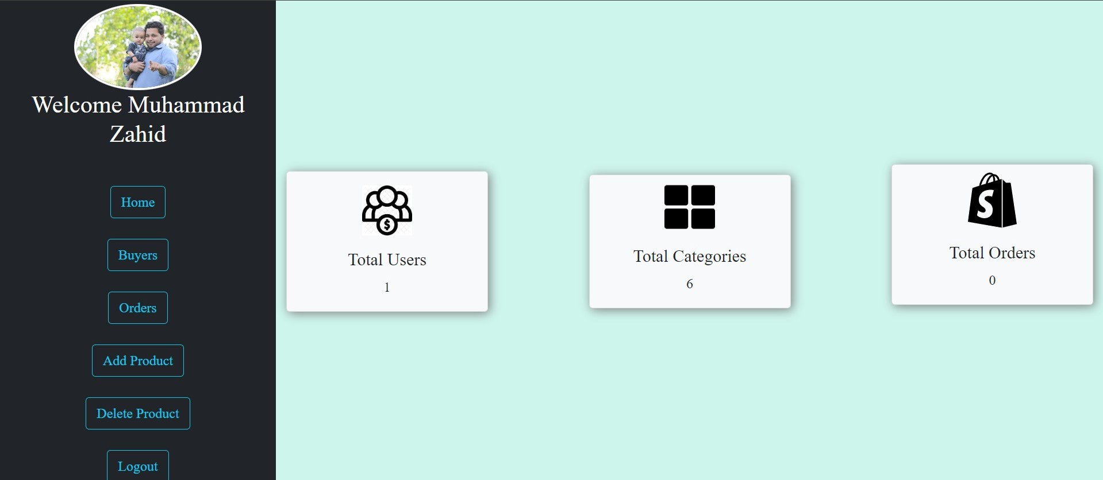
GUI of Admin Page
Created by Zahid Khattak
Created by Zahid Khattak
This Photo by Unknown Author is licensed under CC BY-NC

Slide 11

Thanks !
Created by Zahid Khattak

